Slide 1
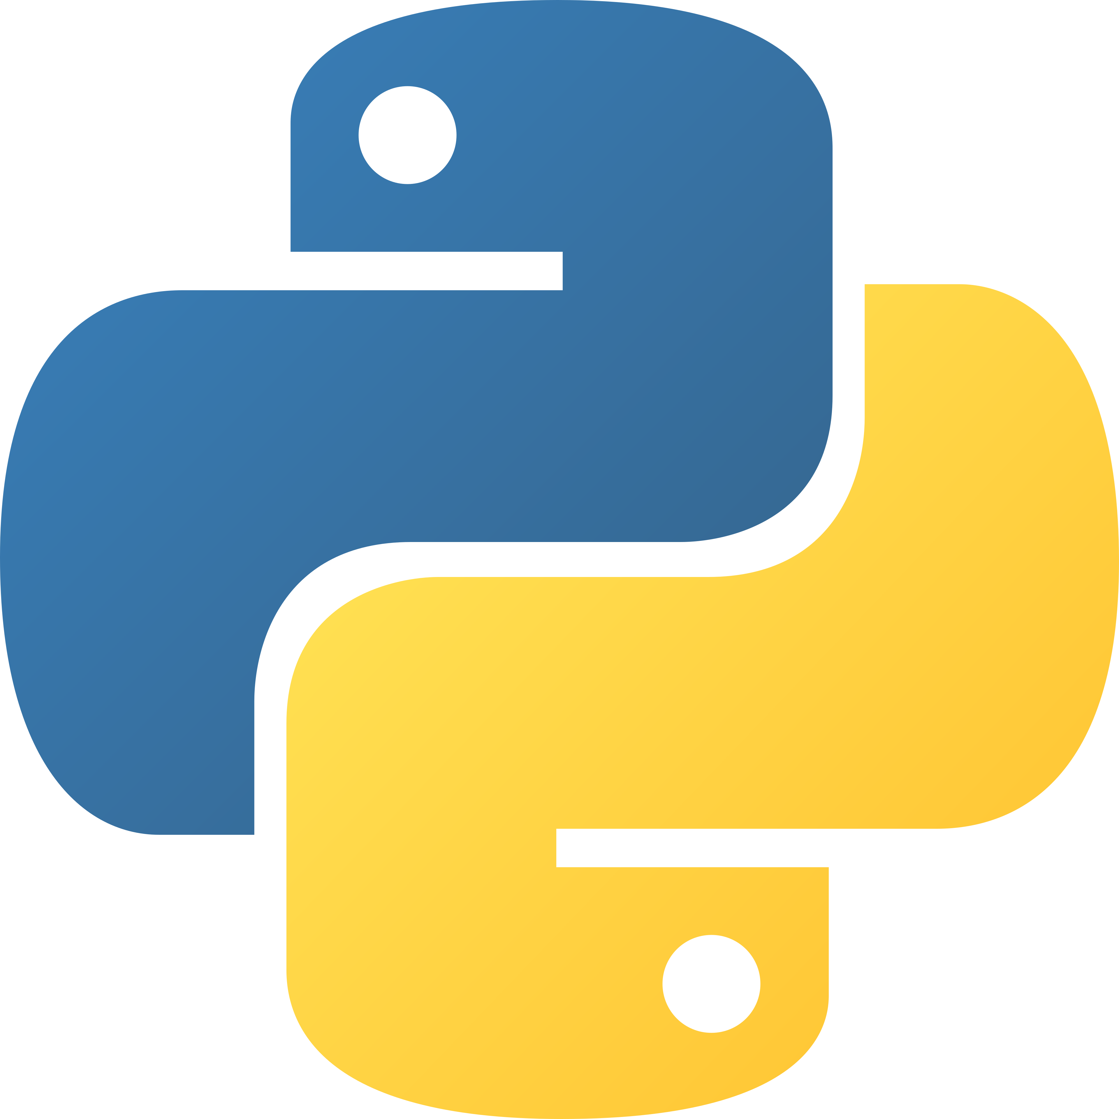
Final Project 🏆
🛡️ Handle errors with try / except
PYTHON FOR BEGINNERS · DAY 10
📝 Plan a project like a programmer
🎓 Build a Student Grade Manager
🎯 Choose and build your own project
Putting it all together
Instructor: Homaira Mohammadi
Notes:
Congratulations on reaching the last lesson! Today students use everything they learned to build a real program.

Slide 2
Everything you’ve learned
LOOK HOW FAR YOU’VE COME 🗺️
1 print() & comments
2 variables, input & operators
3 if / elif / else
4 while loops
5 for loops & range()
6 strings
7 lists
8 functions
9 dictionaries & tuples
That’s enough to build real programs! 💪
Python for Beginners · Day 10: final project
2
Notes:
Take a moment to celebrate. Ask students which lesson was their favourite and which was the hardest.

Slide 3
What if the user types “twenty”?
ONE LAST PROBLEM
age = int(input("Age: "))
The program crashes 💥
Real users make mistakes all the time.
Age: twenty
ValueError: invalid literal for int()
We need a way to catch the error and ask again.
Python for Beginners · Day 10: final project
3
Notes:
Show the crash live. Ask: is it fair that a whole program stops because of one typo? This motivates try/except.

Slide 4
Catch the error instead of crashing
TRY / EXCEPT 🛡️
Code
Output
text = "twenty"
try:
age = int(text)
print("Age:", age)
except ValueError:
print("Not a number!")
Not a number!
try: code that might fail
except: what to do if it fails
Python for Beginners · Day 10: final project
4
Notes:
Other errors you can catch: ZeroDivisionError (dividing by 0), KeyError (missing dictionary key), IndexError (bad list index).

Slide 5
Keep asking until it’s a number
A HELPER FOR EVERY PROJECT
def get_int(prompt):
while True:
try:
return int(input(prompt))
except ValueError:
print("Please type a number.")
age = get_int("Age: ")
Age: twenty
Please type a number.
Age: 20
Combines a function, a while loop and try / except.
Python for Beginners · Day 10: final project
5
Notes:
Students can copy this helper into any project. The notebook version also checks a minimum and maximum value.

Slide 6
How programmers plan a project
THINK BEFORE YOU TYPE 📝
1
2
3
Understand
Plan the data
Split into jobs
What should it do? Who uses it?
Which lists and dictionaries?
Each job becomes a function
4
5
6
Write pseudocode
Build & test
Improve
The steps in plain words
One small piece at a time
Handle bad input, tidy output
Python for Beginners · Day 10: final project
6
Notes:
Pseudocode is writing the steps in normal words before writing Python. Do steps 1 to 4 on the board with the class for the Student Grade Manager.

Slide 7
Student Grade Manager
🎓 OUR PROJECT
The data: name → list of scores
The jobs: one function each
students = {
"Sara": [88, 61],
"Omar": [95],
}
Function | Job
average(scores) | average of a list
get_grade(avg) | A, B, C, D or F
add_student() | add a new student
add_score() | save a score
show_report() | print the table
main() | the menu loop
Python for Beginners · Day 10: final project
7
Notes:
Build the functions one at a time with the class, testing each before moving on. The full code is in the Day 10 lesson notebook.

Slide 8
The menu: main()
🚀 BRING IT TOGETHER
def main():
students = {}
while True:
choice = input("Choose (1-5): ")
if choice == "1":
add_student(students)
elif choice == "2":
add_score(students)
elif choice == "3":
show_report(students)
elif choice == "5":
break
Name Avg Grade
Sara 74.5 B
Omar 95.0 A
A real program, built from everything you learned. 🎉
Python for Beginners · Day 10: final project
8
Notes:
Run the full program from the notebook and add a few students together. Ideas to improve it: delete a student, sort by average, show failing students.

Slide 9
Build small.
Test often.
💡 THE GOLDEN RULE
Write a few lines, run them, fix them — then add the next piece.
Python for Beginners · Day 10: final project
9
Notes:
Beginners often write 100 lines and then run it for the first time, and get 10 errors at once. Professionals run their code every few lines.

Slide 10
Choose one — or invent your own
🎯 YOUR FINAL PROJECT
✊
💸
🔤
Rock, Paper, Scissors
Expense Tracker
Hangman
Best of 3 · ⭐⭐
Totals by category · ⭐⭐
Guess the word · ⭐⭐⭐
🏦
🧠
💡
Bank Account
Quiz Game
Your own idea!
Deposit & withdraw · ⭐⭐
Questions & score · ⭐⭐
Check it with your teacher
Python for Beginners · Day 10: final project
10
Notes:
Briefs and example solutions for the first three are in the Day 10 exercises and solutions notebooks.

Slide 11

Your project should have…
✅ PROJECT CHECKLIST
Variables + a list or dictionary
if / elif / else
At least one loop
At least two of your own functions
No crash on bad input
Comments that explain the code
Clear, friendly output
Python for Beginners · Day 10: final project
11
Notes:
This checklist can also be your marking rubric. Students can tick each item before they present.

Slide 12
4 things to show (3–5 minutes)
🎤 PRESENTING YOUR PROJECT
1
2
3
4
What does your program do?
Show it running — a live demo
Code you’re proud of
What was hard, and how you solved it
Python for Beginners · Day 10: final project
12
Notes:
Presentations can be in the next class. Encourage classmates to ask one question after each demo.

Slide 13
Keep learning
🚀 WHAT’S NEXT?
Topic | What it lets you do
Files — open() | save and load data
Modules — import | use ready-made tools like math and random
Classes (OOP) | create your own data types
turtle / pygame | draw graphics and make games
pandas / matplotlib | analyse data and draw charts
Free practice links are in resources/next-steps.md on GitHub.
Python for Beginners · Day 10: final project
13
Notes:
Encourage students to code a little every day. Small daily practice beats long sessions once a month.

Slide 14
Well done, programmer! 🎉
You finished Python for Beginners.
Instructor: Homaira Mohammadi
Notes:
Thank the students. Congratulate them on finishing the course, and remind them where to find all the materials on GitHub.

